Slide 1
Week 9: The Stance Triangle
Ryan Ka Yau Lai
University of California, Santa Barbara

Slide 2

Before we start …
Open SBC007 on Rezonator
Preferably a previously saved version
Sit with your group members
Shameless plug: You can still enroll in LING 194 Visualising language in conversational interactions, which I teach in summer!
Apply for a scholarship here: https://ucsb.my.site.com/success/s/apply-for-summer-scholarship

Slide 3

Question for today
Find one example of stance in SBC007. Tell us what the stance subject and stance object are, plus the acts of positioning, evaluation, and/or alignment which are explicitly expressed.

Slide 4
In this class, you will …
Practise identifying different parts of the stance triangle and justifying your response
Revisit
Distinguish
Distinguish between epistemic, evaluative and affective stance
Practise
Epistemic upgrade and downgrade

Slide 5
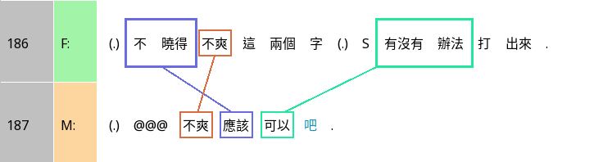
Epistemic downgrade in Chinese: 吧 ba
I don’t know if the words ‘not cool’ can be typed out.
‘Not cool’ should be fine ba.
How does F downgrade her epistemic access?
How does M respond to that?

Slide 6
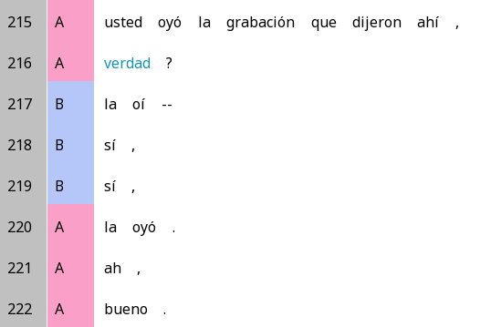
Epistemic downgrade in Spanish: verdad
You heard the recording that they said there,
Can you think of contexts where verdad might be used for epistemic upgrade?
Verdad?
I heard --
Yeah,
Yeah,
I heard it.
Ah.
Good.

Slide 7
Last words on epistemic upgrade/downgrade
Remember that upgrade/downgrade is compared to your expectations regarding the ‘default’ epistemic status in that sequential position
Upgrading – doing something to make yourself appear more knowledgeable than the expected default
Downgrading – doing something to make yourself appear less knowledgeable than the expected default
 | Default epistemic status for FPP | Default epistemic status for SPP
Question/Answer | K- | K+
Assessment | K+ | K-

Slide 8
Epistemic, affective, evaluative
Stance type | About … | Simple examples
Epistemic stance | Your knowledge about something – how much do you ‘know your stuff’? | I think … It might be true that …
Affective stance | Your feelings about something | Yuck! I’m glad about that.
Evaluative stance | Your judgement of something (good vs bad, useful vs useless, etc.) | That’s great!! That’s very useful.
More than one stance can be simultaneously expressed – we’ll look into that soon

Slide 9
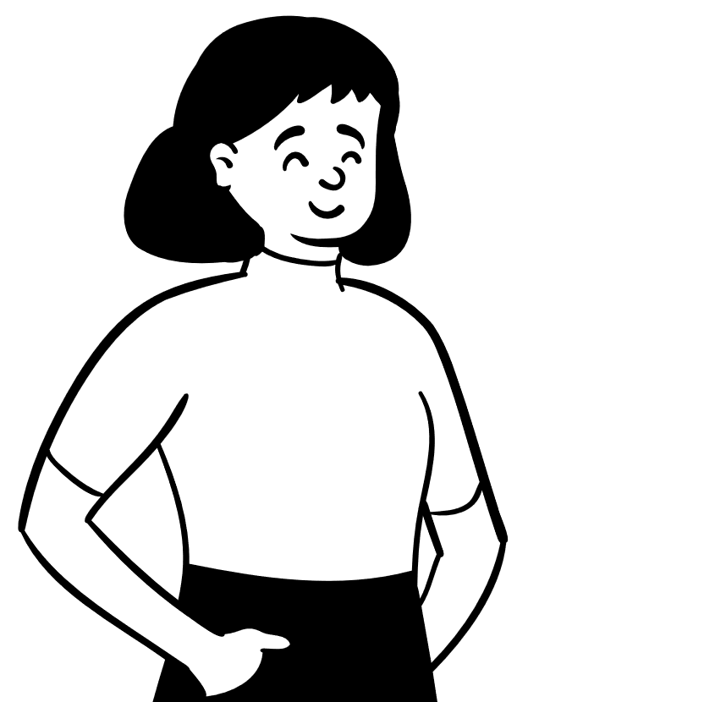
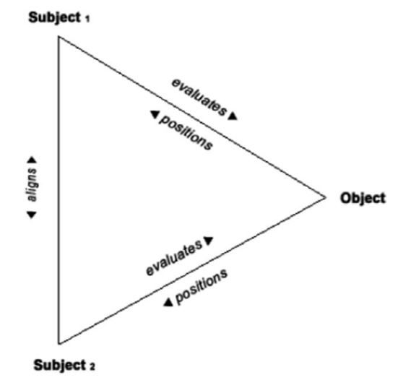



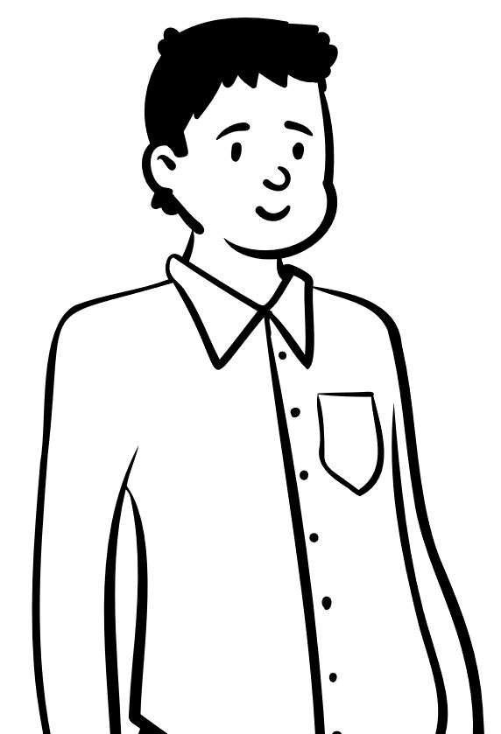

Stance
Stance subjects: The people taking stances
Stance objects: The phenomenon that people are taking a stance about
Evaluation & positioning: Stance subjects’ subjectivity towards the object (more later on)
Alignment: Do people agree, disagree, or have other relationships with the other person’s stance?

Slide 10
Diagraph form of the triangle (lines 306-307)
 | Stance subject | Position |  |  | Stance object |  |  |  |  | Alignment
Alice | I | do | n’t | know | if | she | ‘d | do | it
Mary | I | do | n’t | know | if | she | would |  |  | either
Stance subject
Alice
Position
Uncertainty
Alignment
Agreement
Stance object
if she’d do it
Position
Uncertainty
This is an example of epistemic stance, about your knowledge of the stance object
Stance subject
Mary

Slide 11
Positioning vs evaluation
Positioning: How the stance subject characterises their feeling towards the stance object (it’s mainly about themselves)
Evaluation: What the stance subject thinks the stance object is like (it’s mainly about the stance object)

Slide 12
Identifying positioning vs evaluation
Positioning | Evaluation
I think that’s great! I know it will fail. I’m sick of this! … | That sucks! Wow, this is cool! This will never work. …

Slide 13
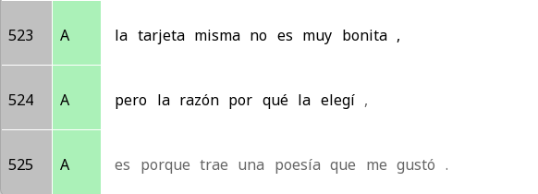
Positioning vs evaluation: Two sides of the same coin?
Evaluation
The card itself is not very pretty,
The card itself is not very pretty,
but the reason why I chose it,
Positioning
Is because it carries a poem that I liked.

Slide 14
The triangle – the card and the poem
Stance subject
A
Stance subject
A
Evaluation
Not very pretty
Positioning
Liking
Stance object
The card itself
Stance object
The poem
Note: We don’t always get all parts of the stance triangle explicitly in the data. That’s OK! (In this case, the transcription cuts off after line 525, so we don’t get the alignment,)

Slide 15

Question: When people do not repeat words when resonating, what are they trying to say?

Slide 16
There’s a few possibilities …
They want to express a different opinion (stance differential)
They’re leaving out stuff that’s obvious and inferable (ellipsis)
They’re leaving out conjunctions that no longer matter
… The possibilities are endless

Slide 17
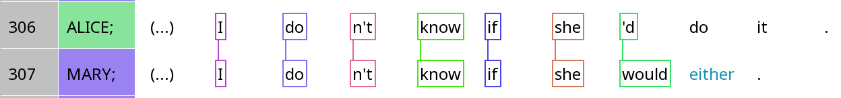
When silence is ellipsis
 | Stance subject | Position |  |  | Stance object |  |  |  |  | Alignment
Alice | I | do | n’t | know | if | she | ‘d | do | it
Mary | I | do | n’t | know | if | she | would | (do) | (it) | either

Slide 18
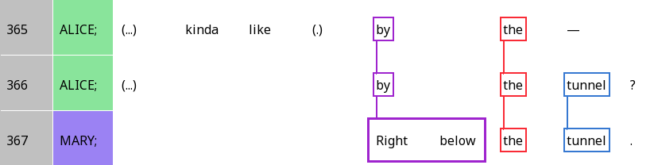
When silence is a stance differential
 | Stance subject | Evaluation | Stance object |  |  | Alignment
Alice | (Alice) | kinda like | by | the | tunnel | ? (seeking confirmation)
Mary | (Mary) | (higher authority) | right below | the | tunnel | . (reserved agreement)

Slide 19
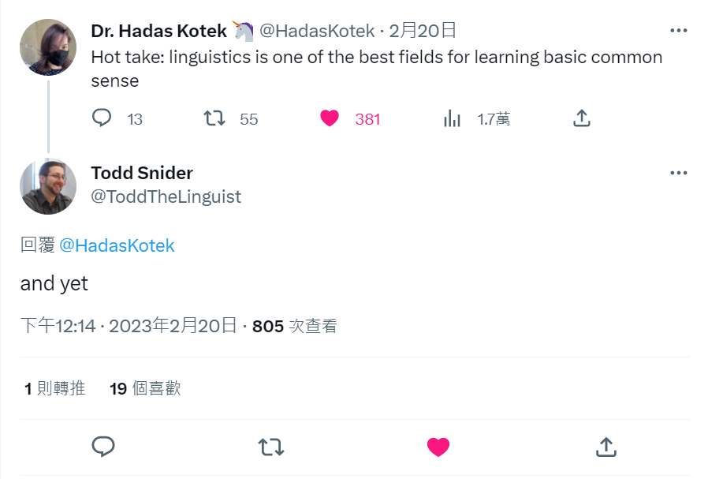
When it’s both …

Slide 20
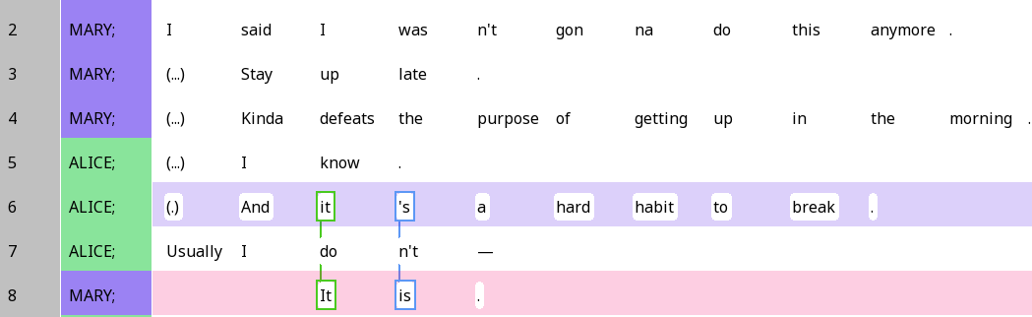
A hard habit to break

Slide 21

A hard habit to break
What kind of stance is this?
How is alignment expressed?
What kind of epistemic stance is expressed in doing so?
 | Stance subject | Stance object | Evaluation |  | Alignment
Alice | (Alice) | it (=stay up late) | is | a hard habit to break
Mary | (Mary) | it (=stay up late) | ‘s | (a hard habit to break) | (agreement, through resonance)

Slide 22
A hard habit to break
 | Stance subject | Stance object | Positioning | Alignment
Alice | (Alice) | It is a hard habit to break | K+
Mary | (Mary) | It‘s a hard habit to break | K- | Use of resonance results in epistemic upgrade, bringing her closer to Alice in terms of knowledge

Slide 23
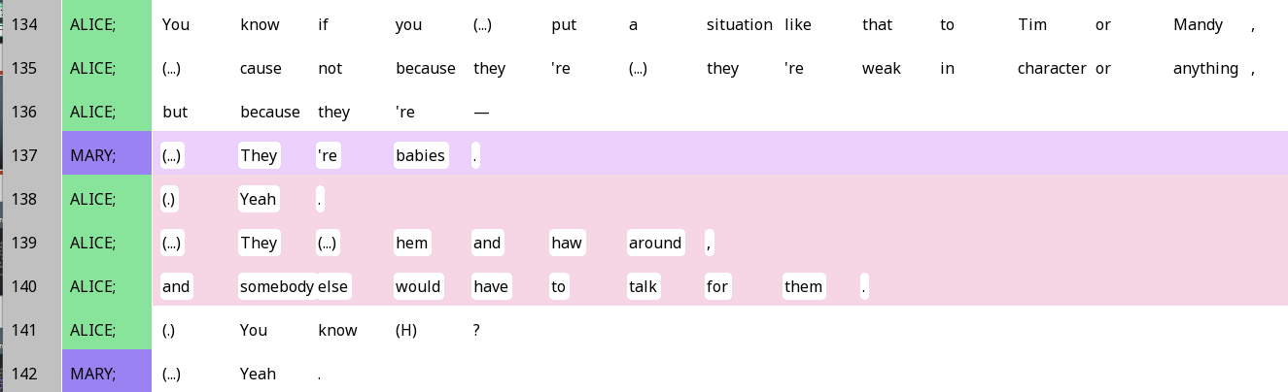
They’re babies

Slide 24
They’re babies
What kind of stance is this?
How is alignment expressed?
What kind of epistemic stance is expressed in doing so?
 | Stance subject | Stance object | Evaluation | Alignment
Mary | (Mary) | they (=Tim & Mandy) | are babies
Alice | (Alice) | they (=Tim & Mandy) | hem and haw around … | Yeah.

Slide 25
They’re babies
 | Stance subject | Stance object | Positioning | Alignment
Mary | (Mary) | they are babies | High knowledge
Alice | (Alice) | they hem and haw around … | Very high knowledge | Epistemic upgrade, even higher than Mary in the end

Slide 26
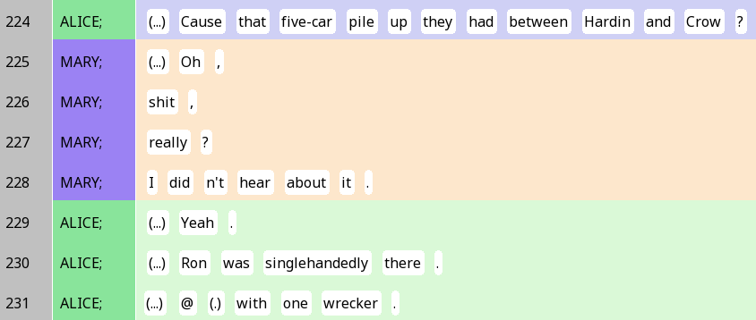
The five-car pileup

Slide 27
The five-car pileup – epistemic stance
 | Stance subject | Stance object | Positioning | Alignment
Alice | (Alice) | That five car pile-up … | (K+)
Mary | (Mary) | (The pileup) | Really? I didn’t hear about it (K-) | Steep epistemic gradient

Slide 28
The five-car pileup: Affective/evaluative
 | Stance subject | Stance object | Evaluation | Alignment
Mary | (Mary) | The pileup | Oh shit, really? (Surprise, negative evaluation)
Alice | (Alice) | The pileup |  | Yeah (Less surprise) Ron was singlehandedly there (agreeing the pileup was bad)

Slide 29

Your turn!
Find one expression of stance in SBC007.
Name the stance subject, stance object, positioning/evaluation, and alignment.

Slide 30
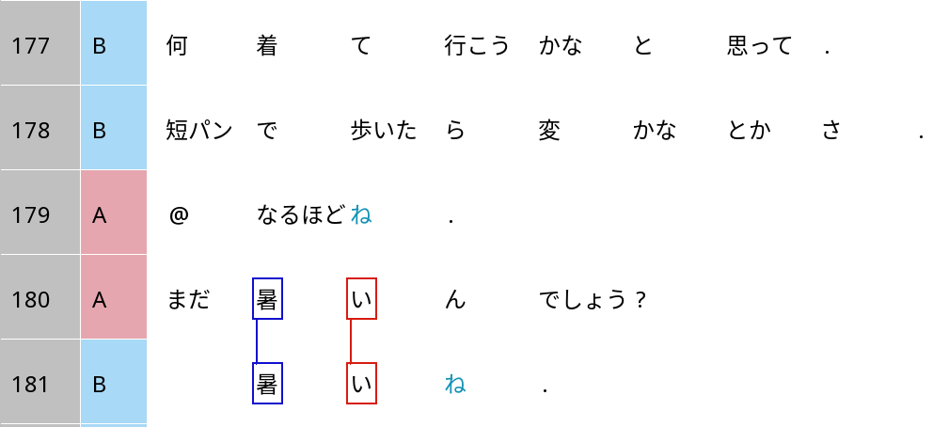
Grammaticalised stance alignment in Japanese: ne
I thought, what should I wear to go?
If I walk around in shorts, would it be weird and stuff?
I see ne.
It’s because it’s perhaps still hot (where B is)?
It’s still hot ne.

Slide 31
Grammaticalised stance alignment in Japanese: ne
It’s because it’s perhaps still hot (where B is)?
It’s still hot ne.
Stance object |  |  | Evaluation | Stance alignment
まだ mada | 暑い atsui | ん n | でしょう deshou | ? ?
still | hot | explanation | ‘Unsure, but I think yes’ | ‘I defer to your opinion.’
 | 暑い atsui |  |  | ね。 ne.
 | hot |  | No uncertainty | ‘Just as you thought.’

